Slide 1

STANDARDS:
SS6G10 Describe selected cultural characteristics of Europe.
  b. Identify the major religions in Europe: Judaism, Christianity, and Islam.
© Brain Wrinkles

Slide 2


Europe’s
Monotheistic
Religions
Judaism, Christianity, & Islam
© Brain Wrinkles

Slide 3

Monotheism
While Europe is home to many religions, Judaism, Christianity, & Islam are major religions practiced there.
These religions have some similarities and even a common history.
Followers of each also practice monotheism, a belief in one god.
© Brain Wrinkles

Slide 4
Similarities
All three believe in one god (monotheistic).
They all started in Southwest Asia.
They can trace their roots to Abraham as the father of their faith.
Jerusalem, Israel is the holiest city in the world for Jews and Christians, and the third holiest city for Muslims.
All three have an important messenger and book of teachings.
© Brain Wrinkles

Slide 5
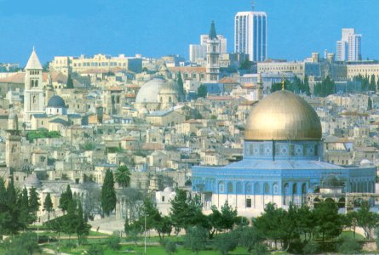
Jerusalem, Israel
© Brain Wrinkles

Slide 6
Judaism
© Brain Wrinkles

Slide 7
Judaism
Followers of Judaism are called Jews.
Judaism was founded by Abraham around 2000 BCE.
Jews believe that God gave Moses the Ten Commandments.
The Jewish holy book is the Torah, which is the oral and written laws of the Jews.
© Brain Wrinkles

Slide 8
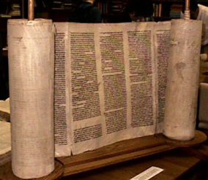
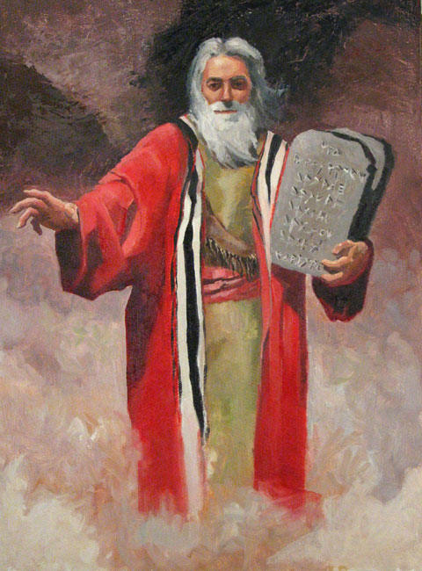
Moses
The Torah
© Brain Wrinkles

Slide 9
Judaism
Jews believe that they descended from Abraham and Sarah, the first people to worship Yahweh (God).
Abraham lived at least 3,700 years ago in what is now Iraq.
© Brain Wrinkles

Slide 10
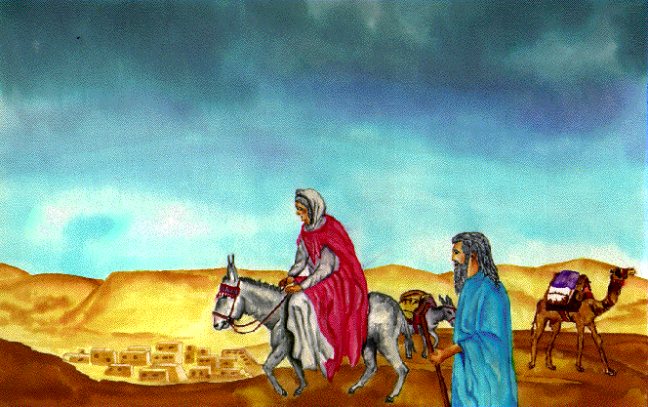
Abraham & Sarah
© Brain Wrinkles

Slide 11
Judaism
Jews worship in synagogues and temples.
They believe that a messiah (savior) will lead them to the Promised Land.
“What is hateful to you, do not to your neighbor.”
How do you feel about this?
© Brain Wrinkles

Slide 12
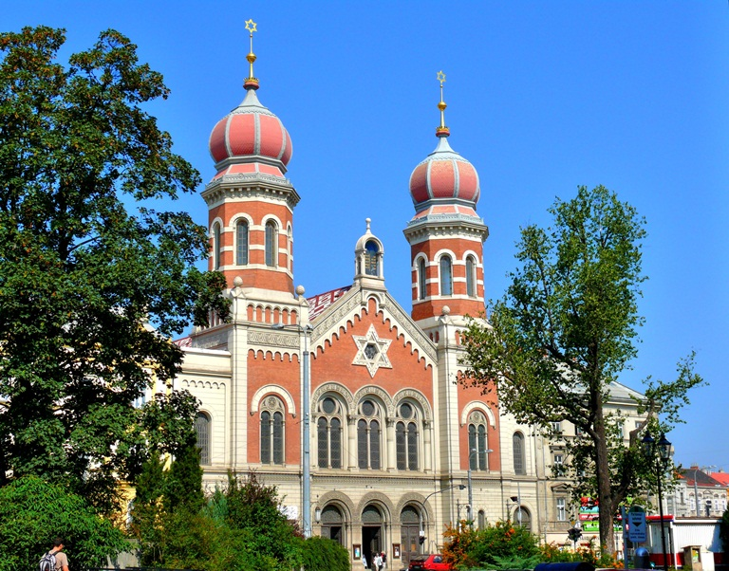
Largest Synagogue in Europe
© Brain Wrinkles

Slide 13
Judaism
Small populations of Jews have lived in Europe for centuries.
Today, most European Jews live in the United Kingdom, France, Russia, and other former-Soviet Union countries.
There are about 15 million followers of Judaism today.
© Brain Wrinkles

Slide 14
Christianity
© Brain Wrinkles

Slide 15
Christianity
Christianity actually has its roots in Judaism.
Christians believe in Jesus, who preached a new religion of love and kindness around 30 CE.
  Christians believe that Jesus was the messiah (savior).
© Brain Wrinkles

Slide 16
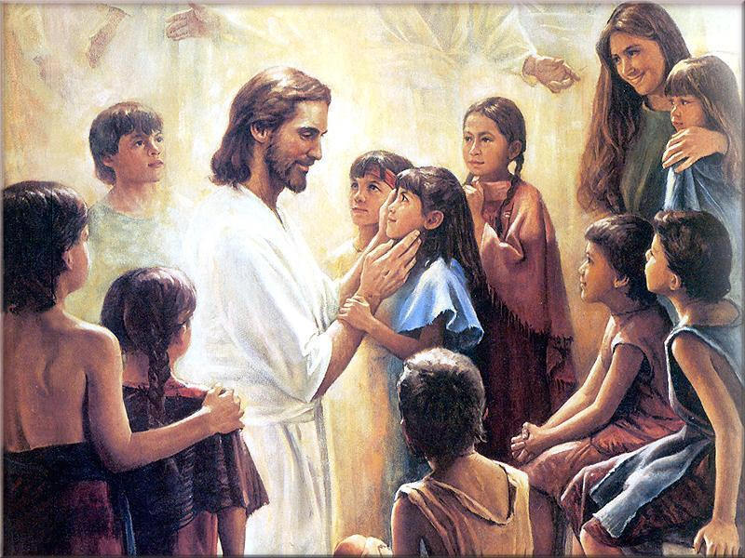
Jesus
© Brain Wrinkles

Slide 17
Christianity
The Bible is the main holy book for Christians.
It consists of the Old Testament and the New Testament.
© Brain Wrinkles

Slide 18

The Bible
© Brain Wrinkles

Slide 19
Christianity
Christians are grouped by many denominations.
  Examples include Catholicism, Orthodoxy, and Protestantism.
All denominations of Christians follow the teachings of Jesus.
Christians worship in churches, cathedrals, and chapels.
© Brain Wrinkles

Slide 20
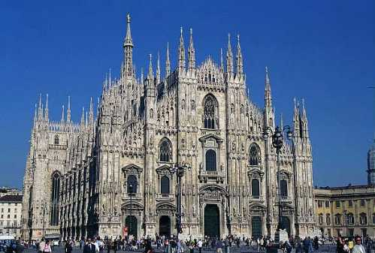
Cathedral in Milan, Italy
© Brain Wrinkles

Slide 21
Christianity
Christianity is the dominant religion in Europe.
The majority of Catholics live in the southern region in France, Spain, & Italy.
More Protestants live in northern countries like Germany and the United Kingdom.
Most Eastern Europeans (including Russians) practice Eastern Orthodox Christianity.
There are about 2.1 billion Christians today.
© Brain Wrinkles

Slide 22
Islam
© Brain Wrinkles

Slide 23
Islam
Islam began around 610 CE in Southwest Asia.
In Arabic, Islam means “surrender” to the will of Allah (God).
Followers of Islam are called Muslims, and the founder is Muhammad.
Muslims believe that Muhammad is the last and greatest prophet of Islam.
  Other prophets include Abraham, Moses, & Jesus.
© Brain Wrinkles

Slide 24
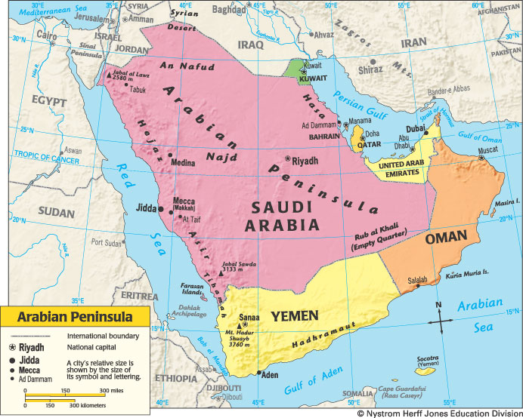
© Brain Wrinkles

Slide 25
Islam
The Muslim holy book is the Qur’an (Koran).
  It states how people should live their lives.
It describes the Five Pillars of Faith (obligations all Muslims must fulfill in their lifetime).
© Brain Wrinkles

Slide 26
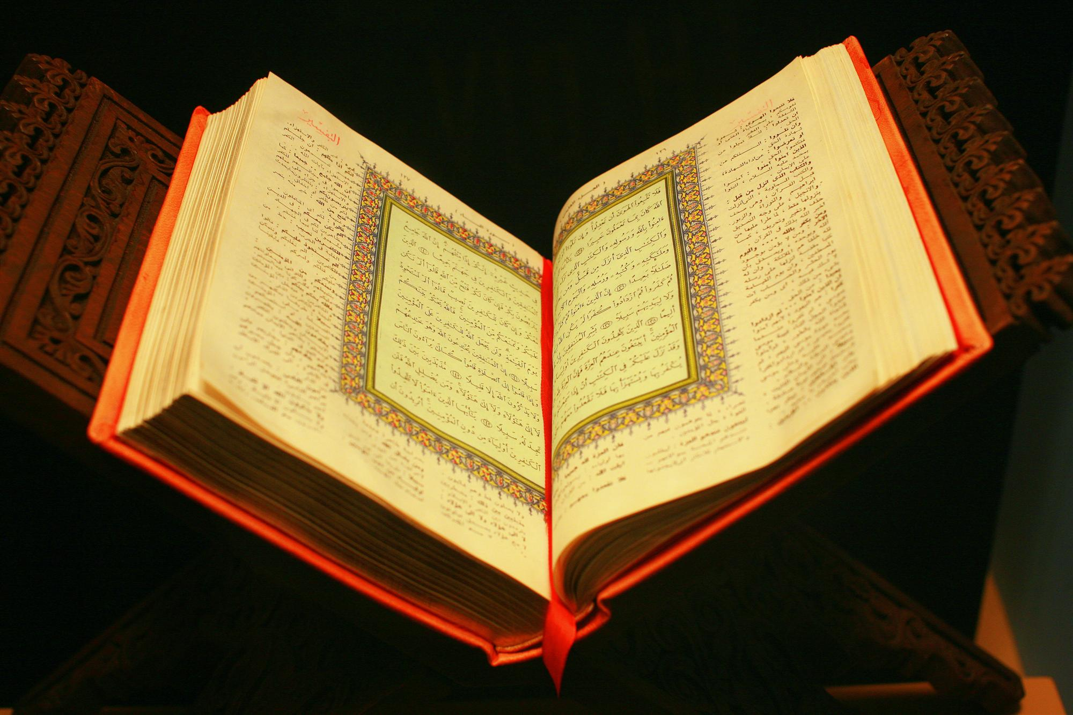
The Koran
© Brain Wrinkles

Slide 27
Islam
  Five Pillars of Faith:
  (the main duties of Muslims)
    1. Prayer,
    2. Giving to charity,
    3. Belief in and submission to one God (Allah),
    4. Fasting during the month of Ramadan,
    5. and a trip (hajj) to Mecca once in a lifetime.
© Brain Wrinkles

Slide 28
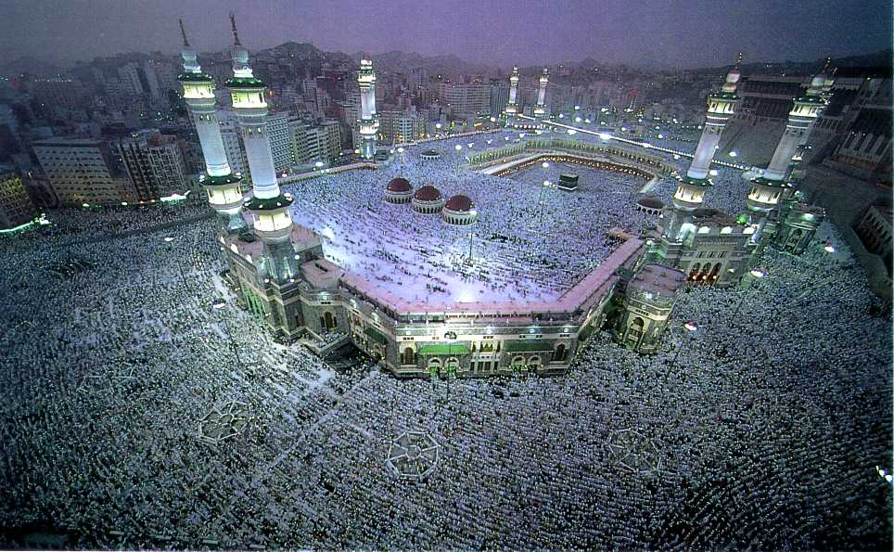
The Grand Mosque in Mecca
© Brain Wrinkles

Slide 29
Islam
The two largest groups of Muslims are the Sunnis and the Shiites.
  The Sunnis account for about 90% of the world’s Muslims.
Many Muslims are immigrating to Western Europe, making Islam the fastest growing religion in Europe.
Muslim populations are highest in France, UK, and Germany, and in Eastern European countries like Bosnia and Albania.
Today, there are about 1.3 billion followers of Islam.
© Brain Wrinkles

Slide 30
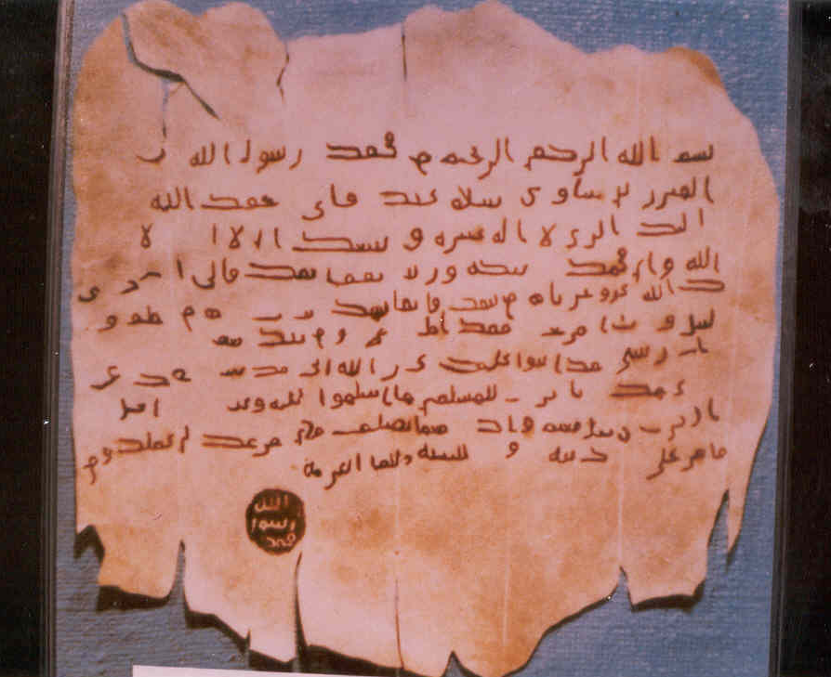
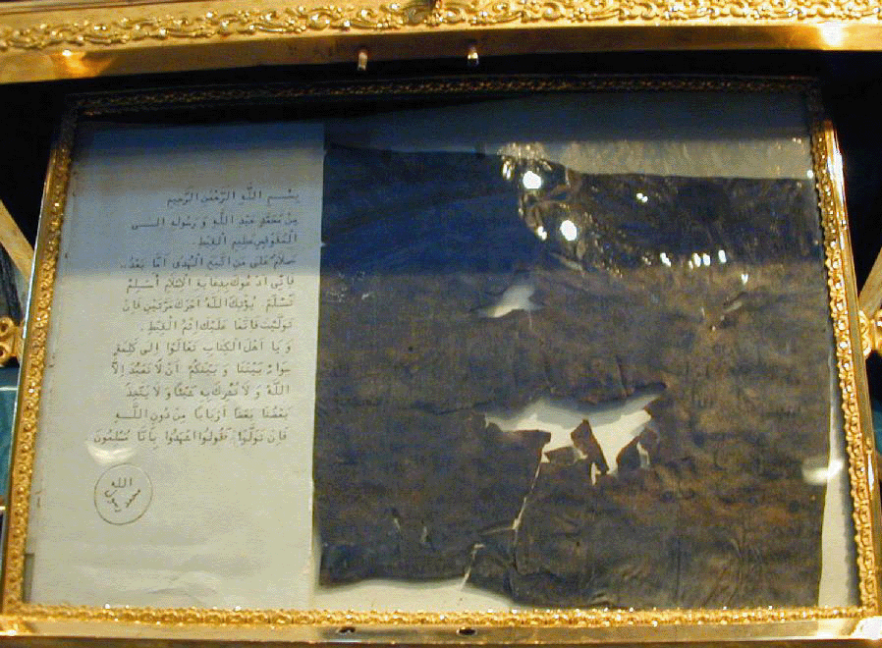
Two letters written by Muhammad…so old!
© Brain Wrinkles

Slide 31
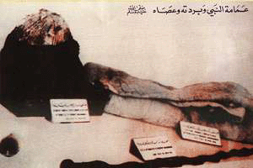
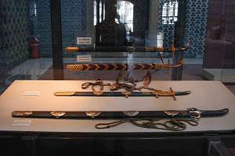
Muhammad’s Hat, Robe, & Staff
Muhammad’s Swords
© Brain Wrinkles

Slide 32
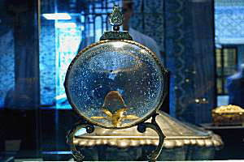
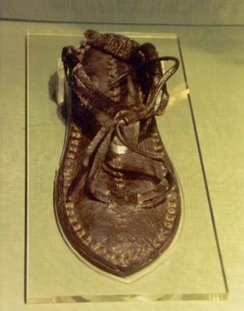
A Piece of Muhammad’s Hair
Muhammad’s Sandal
© Brain Wrinkles

Slide 33
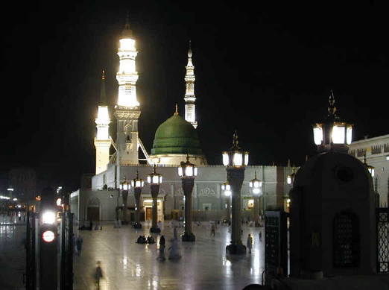
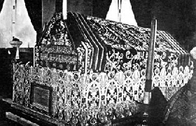
The Green Dome in Medina
Muhammad’s grave lies under the Green Dome.
© Brain Wrinkles

Slide 34
Important Facts
Location in Europe
Followers & How Many
Date Began
Holy Book
Founder
© Brain Wrinkles
Judaism
Directions: Complete the chart below with information that you learn during the presentation.
Europe’s Religions
Christianity
Islam

Slide 35

Meet the Religions: Caricatures
Directions: If the people below were speaking about their religion, what would they say? Include information about the religion’s founder, holy book, followers,, etc. Add clothing, facial expressions, and symbols to help distinguish who the people are when you are finished writing.
Judaism: ___________________________________________ | Christianity: __________________________________________
Islam: ____________________________________________ | Write down 3 interesting (and new to you) facts that you learned today.
© Brain Wrinkles

Slide 36
Commemorative Coin
Directions: Design a coin to commemorate Europe’s religions. On the back, write a paragraph that describes the design and why/how it represents Europe’s religions.
Front
Back
© Brain Wrinkles

Slide 37
1. Which is the oldest of the three religions?
2. Which religion is the historical foundation for the Christianity?
3. Which religion did Muhammad found in the 7th century?
4. Which faith is the dominant religion in Europe?
5. Which religion is growing at the fastest rate?
6. Which is the first recorded religion to worship only one God?
7. How are all three religions alike?
8. Name the sacred text for each religion:
9. Countries in Eastern Europe (like Albania and Bosnia) have high populations of which religion?
10. Jerusalem, Israel is the holiest city for which religion(s)?
© Brain Wrinkles
Europe’s Religions Comprehension Check

